Slide 1
Transport Layer
Aiden Martin

Slide 2
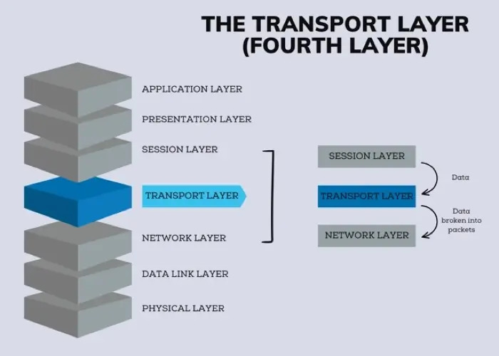
The Transport layer
The Transport Layer is the 4th layer of the OSI model, and the 3rd layer of the TCP/IP model

Slide 3
What is the transport layer
The Transport Layer is the 4th layer of the OSI model. It acts as a bridge between the upper layers (application, session, presentation) and the lower layers (network, data link, physical). Its primary role is to provide logical communication between application processes running on different hosts.

Slide 4
Key Responsibilities
Segmentation
End-to-End
Port addressing
Divides large messages into smaller segments and reassemble at location
Manages complete data transfer from source to destination application
Identifies specific applications using the hosts port number
Error Detection
Connection Management
Flow Control
Checks for corruption and retransmits lost or damaged data
Establishing and terminating connections through the handshake method
Regulates data transmission speed to prevent network overload

Slide 5
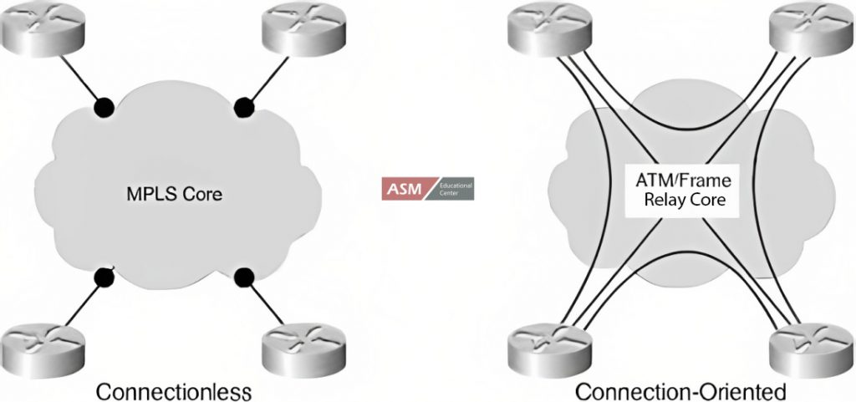
TCP VS UDP
TCP
UDP
Transmission control Protocol
Connection bassed
Ordered
Flow/congestion control
Harder to implement
User datagram protocol
Conectionless
No ordering
No flow/congetsion control
Easier to implement

Slide 6
TCP in depth
TCP treats data as a continuous stream of bytes.
Before any data is sent, a connection must be established via the three-way handshake (SYN → SYN-ACK → ACK).
Every byte sent is numbered with a sequence number, and the receiver must acknowledge receipt.
If an acknowledgement isn't received within a timeout period, the data is retransmitted automatically.
Key Mechanisms:
- segmentation
-sequence numbers
-flow/congestion control
-connection termination

Slide 7
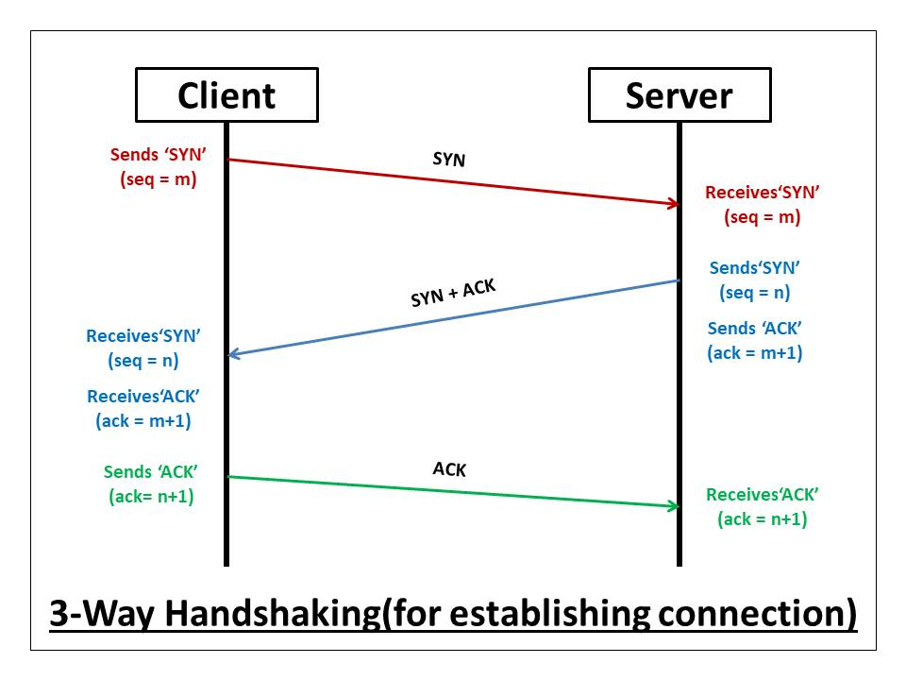
Three way handshake
How TCP establishes connections befor data transfer

Slide 8
UDP in depth
UDP simply packages application data into a datagram and sends it.
There is no handshake, no acknowledgement, no retransmission, and no ordering guarantee.
The sender fires packets and forgets them.
If a packet is lost, corrupted, or arrives out of order, UDP does nothing — it's entirely up to the application layer to handle this if needed.
Key characteristics:
- multicast & broadcast support
-checksum

Slide 9
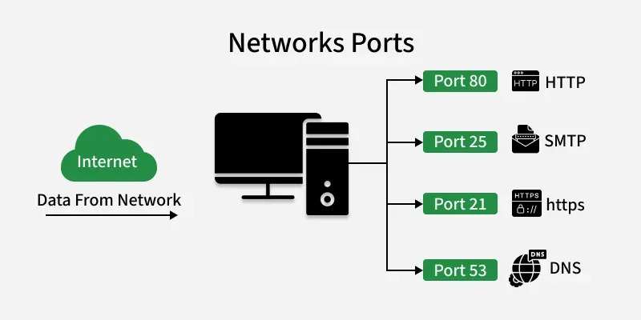
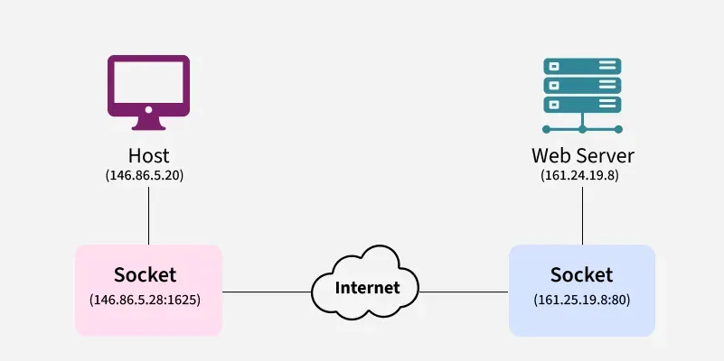
Ports and Sockets
Port = 16 bit integer that identifies a service
Its how the transport layer identifies which application should receive data
SOCKET = IP Address + Port Number
Key ideas: client socket, socket pair, server socket, and Multiplexing

Slide 10
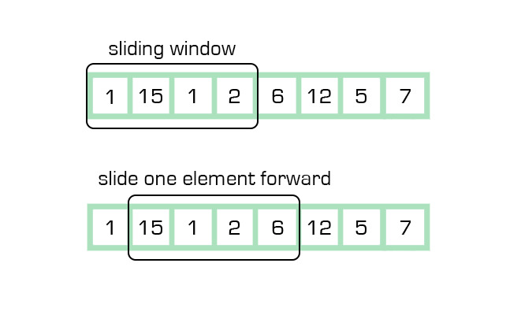
Flow and congestion control
Preventing overwhelming the receiver
Tcp uses the sliding window mechanism
Key ideas:
windowing
Receive widow
Zero window
Window scaling
Slow start
How TCP detects and responds to network congestion
Key ideas:
Fast transmit
Fast recovery
Congestion avoidance
Slow start

Slide 11
Error Detection
How Tcp guarantees data integrity and completeness:
Checksums
- detect errors in transmitted data by verifying that what was sent matches what was received.
Sequence numbers
- label packets in order so the receiver can reassemble them correctly even if they arrive out of order.
Acknowledgments
-confirmations sent by the receiver to the sender to indicate that a packet was successfully received.
Retransmission timeout
-the time a sender waits for an acknowledgment before assuming a packet was lost and resending it.

Slide 12
Retransmission
1
2
GO-Back-N
Selective Repeat
3
Stop and wait

Slide 13
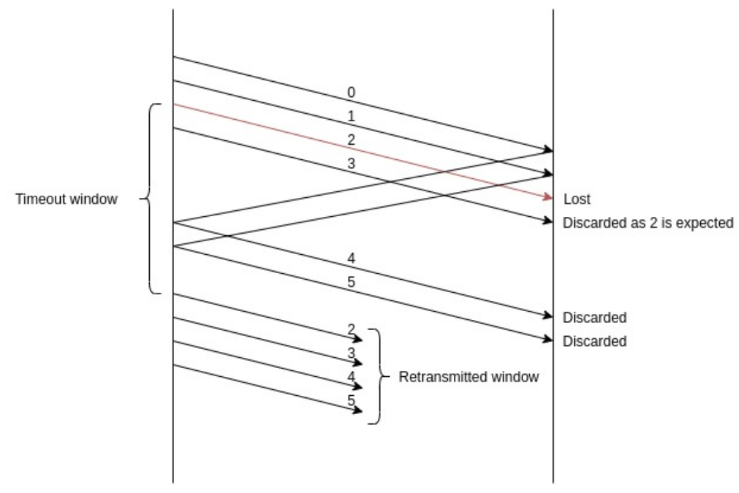
GO-Back-N
Go back n uses a sliding window if the acknowledgement for a window isnt received it resends all of the frames in the window

Slide 14
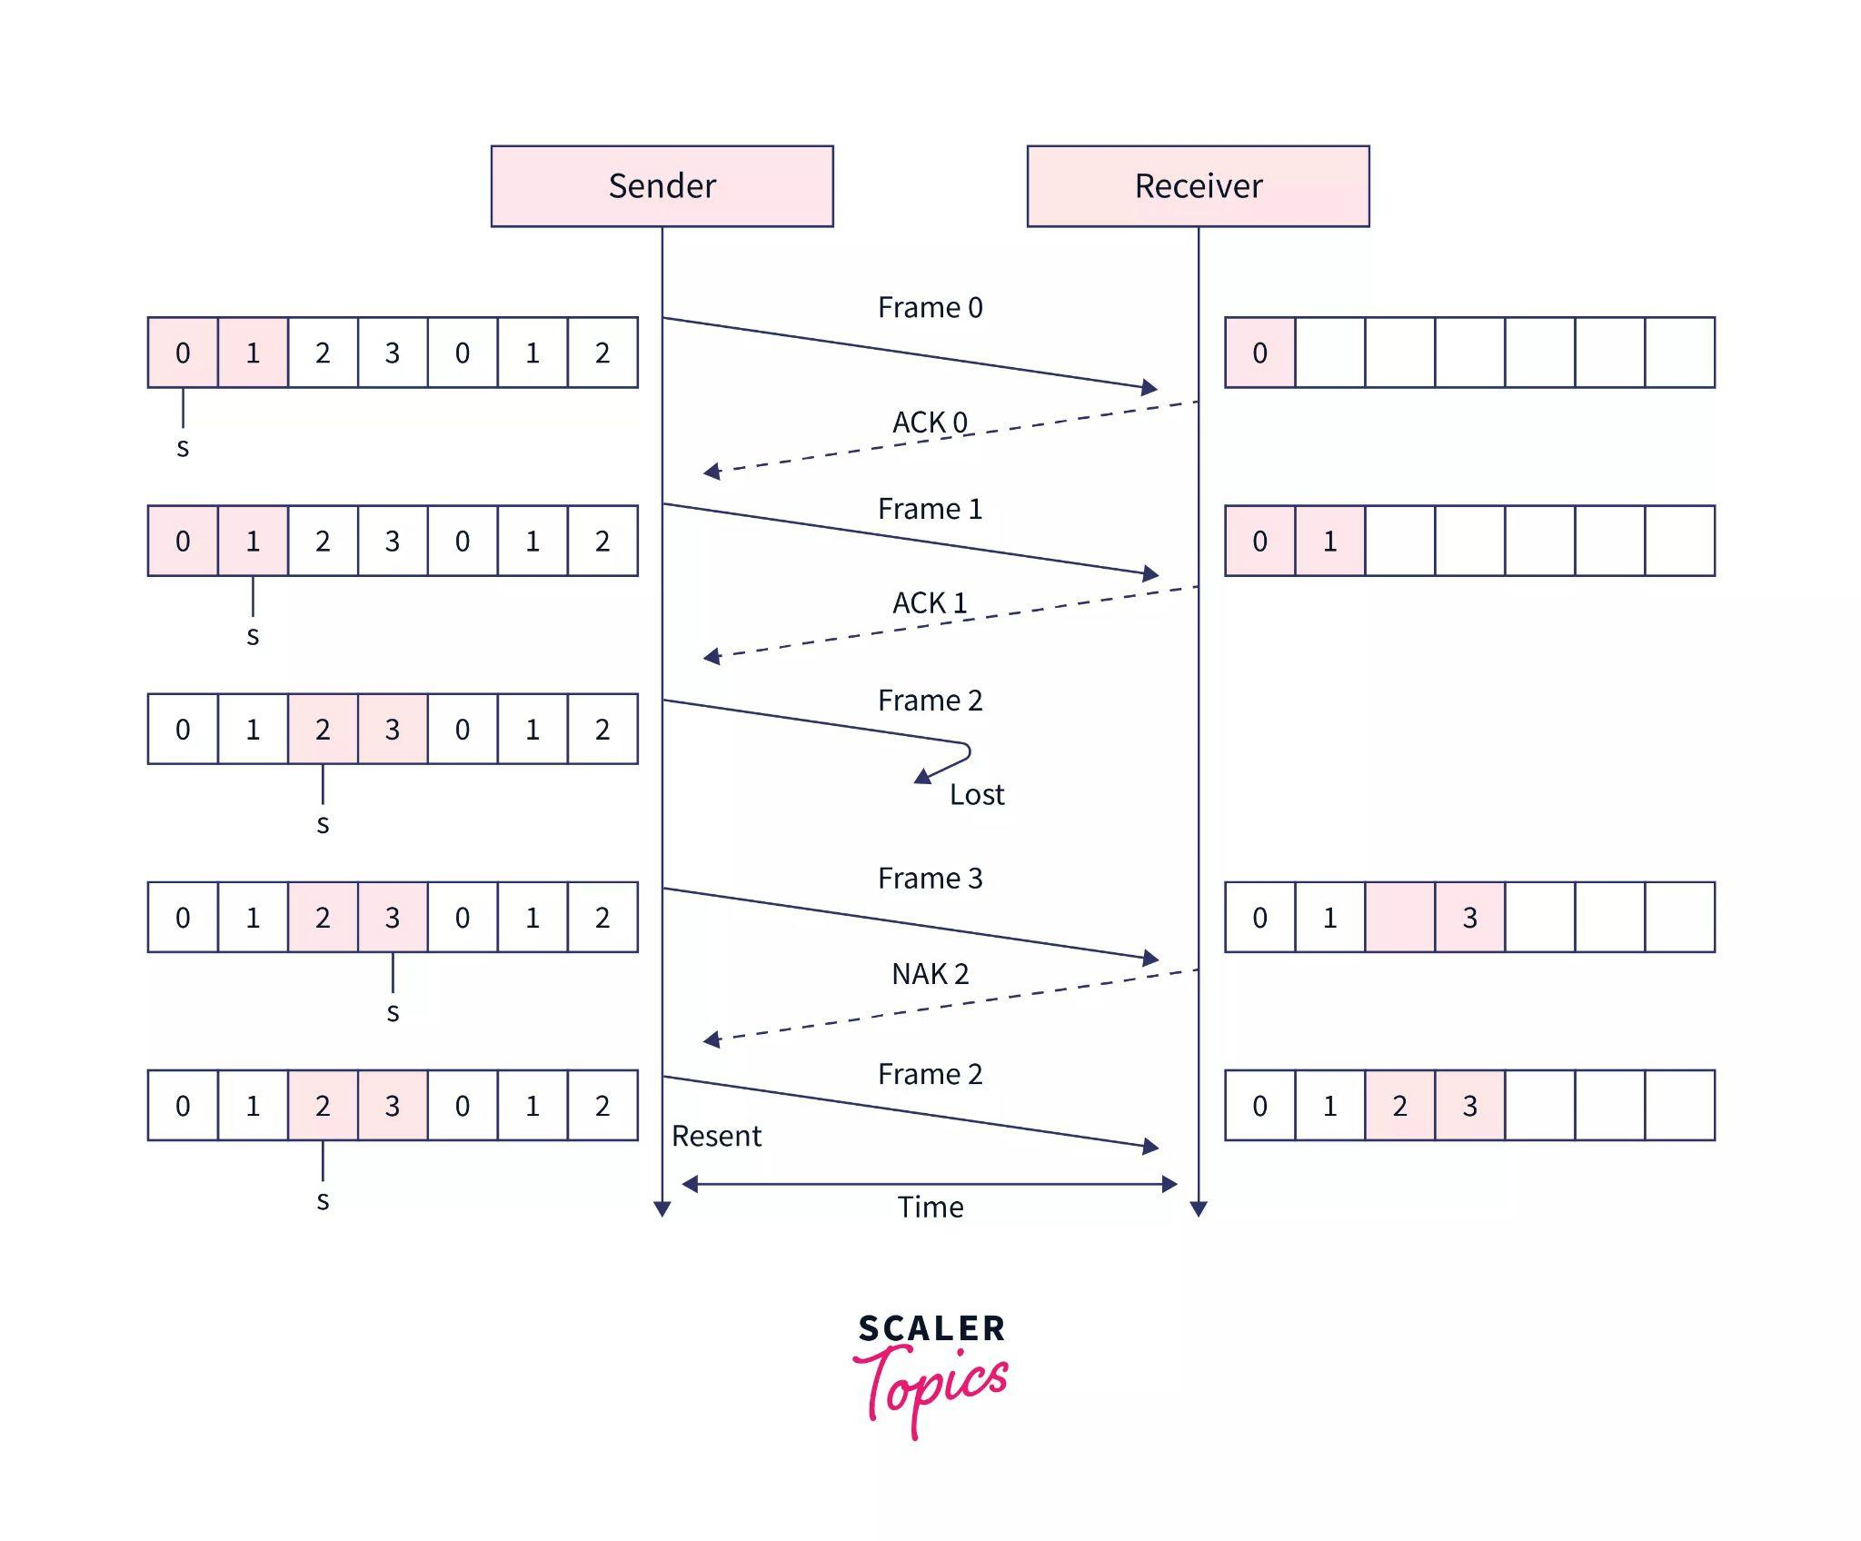
Selective Repeat
Selective repeat is when a frame is lost it sends only the missing frame and continues which is harder to implement then the other two

Slide 15
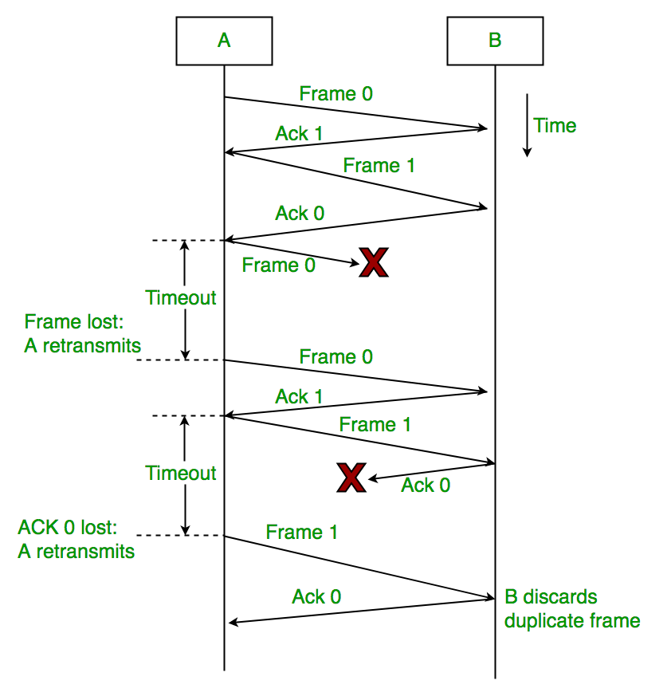
Stop and Wait
Stop and wait happens if a frame was lost, it times out and waits then the same frame gets retransmitted

